Slide 1
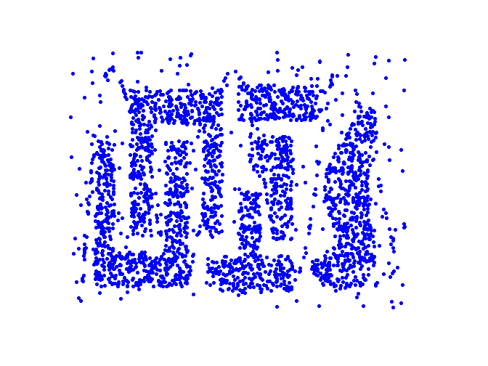
Density-based clustering
DBSCAN (Density-based spatial clustering of applications with noise)

Slide 2
DBSCAN
DBSCAN is a density-based algorithm.
Density = number of points within a specified radius (Eps)
A point is a core point if it has more than (including itself) a specified number of points (MinPts) within Eps
These are points that are at the interior of a cluster
A border point has fewer than MinPts within Eps, but is in the neighborhood of a core point
A noise point is any point that is not a core point or a border point.

Slide 3
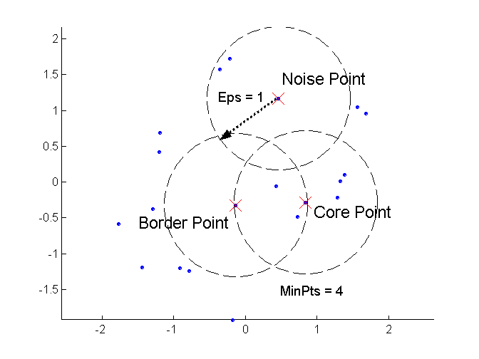
DBSCAN: Core, Border, and Noise Points

Slide 4
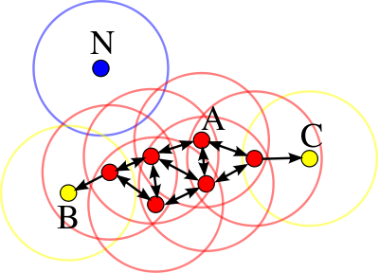
DBSCAN: Core, Border, and Noise Points

Slide 5
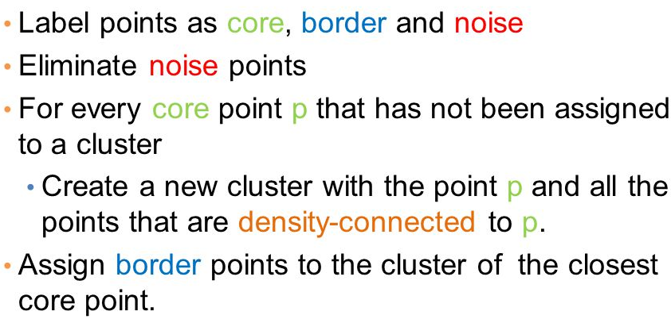
DBSCAN Algorithm

Slide 6
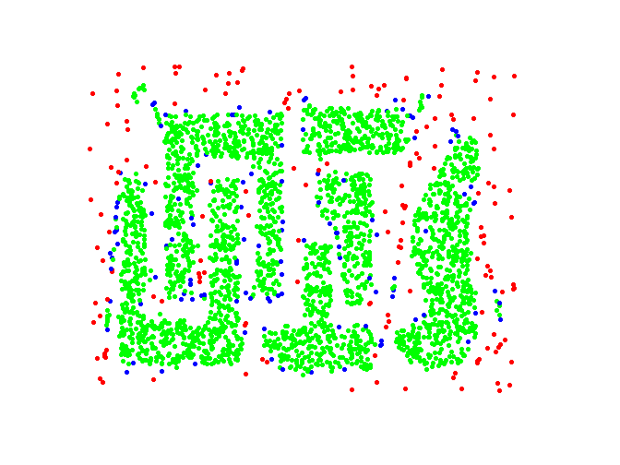
DBSCAN: Core, Border and Noise Points
Original Points
Point types: core, border and noise
Eps = 10, MinPts = 4

Slide 7
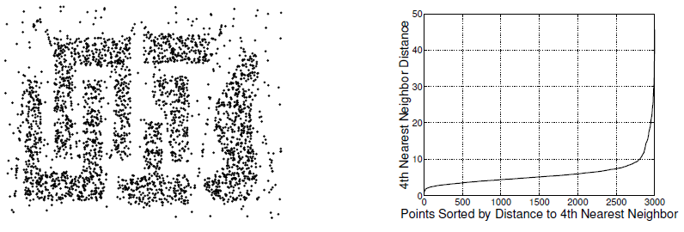
DBSCAN: Finding Eps
How to determine suitable value of Eps?
Select a number k, then for each data point calculate k-dist distance to its k^{th} nearest neighbour
Sort these k-dists in increasing order and plot the sorted values
Look for the knee in the curve - it is a suitable value of Eps
For 2D data, 4 is a reasonably good value for k

